Slide 1
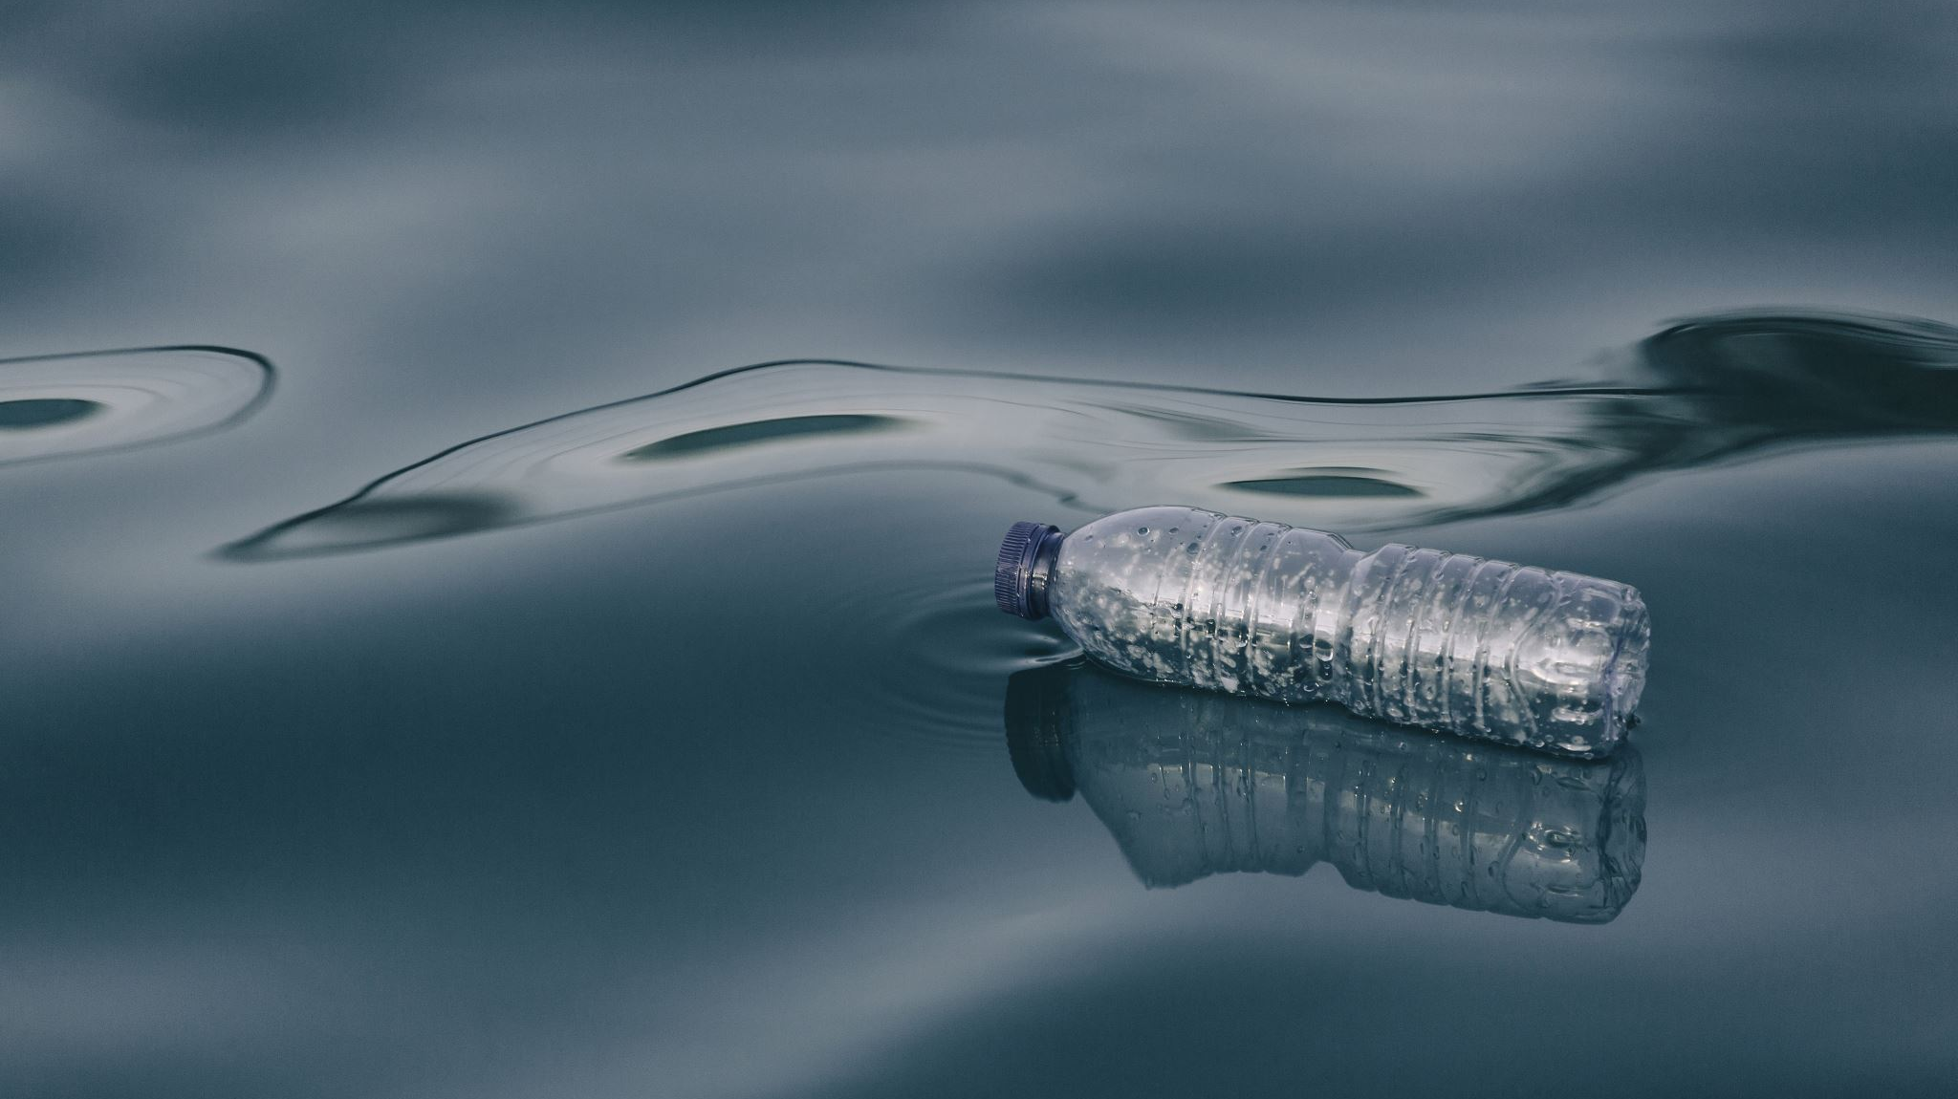
FAITH, FEAR, AND FOLLY DURING A PANDEMIC
Nehemiah 4:7-15

Slide 2
Faith, Fear, And Folly During A Pandemic
History of Nehemiah.
Nehemiah’s interest in his brethren!
Nehemiah’s initial preparation. 1:8-9,11;
2:4-8; 2:12-20
Organized for the work. Chapter 3
Zeal for the work in spite of the ridicule.
4:1-6, 20
Read The Text: Nehemiah 4:7-15

Slide 3
Faith, Fear, And Folly During A Pandemic
Faith primarily refers to our trust in God.
Hebrews 11:7; Acts 27:22, 25
But faith is not to be confused with folly.
cf. Matthew 4:6, “if you are the Son of God, throw yourself down”
But how do we determine when FAITH becomes FOLLY?
How do we know when what seems to be PRUDENCE is really disguised FEAR?

Slide 4
Faith, Fear, And Folly During A Pandemic
The people of Jerusalem faced multiple crises in the time of Nehemiah.
    A city without walls was a city without security.
    A crushing burden to those few Jews who were committed to the task.
    The threat of violence from Israel’s enemies.

Slide 5
Faith, Fear, And Folly During A Pandemic
NOTE: “Our God Will Fight For Us.” Nehemiah 4:20
Nehemiah exhorted, “Do not be afraid of them.” “Remember the Lord, who is great and awesome.”
Nehemiah 4:14 NASV
The faith of the people prompted them to build as they took up arms to defend their city.

Slide 6
Faith, Fear, And Folly During A Pandemic
So, how was the city saved?
God had “frustrated their plan.” NASV “brought their counsel to nought.” ASV Nehemiah 4:15
God worked through Nehemiah and the people. “And it came to pass from that time forth, that half of my servants wrought in the work, and half of them held the spears, the shields, and the bows, and the coats of mail … They all builded the wall and they that bare burdens laded themselves; every one with one of his hands wrought in the work, and with the other held his weapon.” Nehemiah 4:16-17

Slide 7
Faith, Fear, And Folly During A Pandemic
Faith that trusts works!
God provides our daily bread through our labor.
Matthew 6:11; 2 Thessalonians 3:10
God heals the sick through the prayer of elders and the anointing of oil. James 5:14-15
God comforts us through our brothers. 2 Corinthians 7:6
God works through creation
He “waters the mountains” and causes “the grass to grow” and feeds the “young lions” through the natural processes which He made and governs. Psalms 104:13, 14, 21

Slide 8
Faith, Fear, And Folly During A Pandemic
Principles applied:
Wearing a mask to prevent inadvertently spreading it, and receiving a vaccine to keep from getting it, and receiving medical treatment while having it.
      God works through people and nature to bring about His purposes.
      We work because we trust that God works.
      Philippians 2:12-13

Slide 9
Faith, Fear, And Folly During A Pandemic
This body, this creation, and this life, are NOT all there is.
2 Timothy 4:18, “The Lord will deliver me from every evil work, and will save me unto his heavenly kingdom: to whom (be) the glory forever and ever. Amen.”
Philippians 1:21-23, “For to me to live is Christ, and to die is gain. But if to live in the flesh, – (if) this shall bring fruit from my work, then what I shall choose I know not. But I am in a strait betwixt the two, having the desire to depart and be with Christ; for it is very far better”

Slide 10
Faith, Fear, And Folly During A Pandemic
Paul’s Faith Failed Not, Yet …
He escaped in a basket let down over a wall in Damascus. Acts 9:25
He laid low in Tarsus. Acts 9:29-30
He appealed to Caesar. Acts 25:11-12
He willingly suffered more than we can imagine
(2 Corinthians 11:23-28), yet, there were times when he sidestepped grave harm.

Slide 11
Faith, Fear, And Folly During A Pandemic
Same True of the Church in Jerusalem:
Acts 8:1-4, “And Saul was consenting unto his death. And there arose on that day a great persecution against the church which was in Jerusalem; and they were all scattered abroad throughout the regions of Judaea and Samaria, except the apostles. And devout men buried Stephen, and made great lamentation over him. But Saul laid waste the church, entering into every house, and dragging men and women committed them to prison. They therefore that were scattered abroad, went about preaching the word.”

Slide 12
Faith, Fear, And Folly During A Pandemic
Living by faith – faithlessness or foolishness?
Paul returned to Lystra. Acts 14:19-22
Paul escaped at night with an armed guard. Acts 23:21-31
Not a “one size fits all” in matters of judgment.
Faith in God’s protection and taking precautions are not mutually exclusive. Nehemiah 4:14, 20;
cf. Nehemiah 4:13, 17, 21

Slide 13
Faith, Fear, And Folly During A Pandemic
In such matters of judgment, above all else, charity toward one another should prevail.
“For ye, brethren, were called for freedom; only (use) not your freedom for an occasion to the flesh, but through love be servants one to another. For the whole law is fulfilled in one word, (even) in this: Thou shalt love thy neighbor as thyself. But if ye bite and devour one another, take heed that ye be not consumed one of another.”
Galatians 5:13-15

Slide 14
Faith, Fear, And Folly During A Pandemic
In such matters of judgment, above all else, charity toward one another should prevail.
Romans 14:13, “Let us not therefore judge one another any more: but judge ye this rather, that no man put a stumblingblock in his brother's way, or an occasion of falling.”
Romans 14:19, “So then let us follow after things which make for peace, and things whereby we may edify one another.”
Romans 15:5-7, “Now the God of patience and of comfort grant you to be of the same mind one with another according to Christ Jesus: that with one accord ye may with one mouth glorify the God and Father of our Lord Jesus Christ. Wherefore receive ye one another, even as Christ also received you, to the glory of God.”

